Slide 1
Instruction Execution and Sequencing

Slide 2
Outline
Instruction Execution procedure
Instruction Sequencing
Straight Line Sequencing
Branching
Subroutines
Call and Return mechanism
Subroutine Linkage method

Slide 3
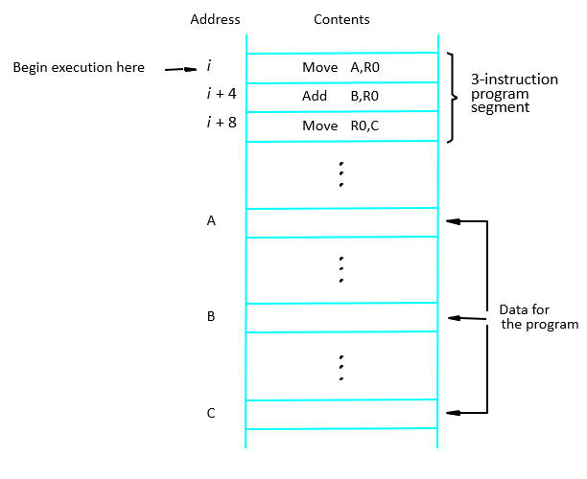
A program for c ←[A]+[B]

Slide 4
Instruction execution…
It is a Two phase procedure :
Instruction Fetch
Instruction Execution
‘i’ is placed into the PC
the processor control circuits use the information in the PC to fetch instructions, one at a time.
Fetching is in the order of increasing addresses and is called straight-line sequencing
Then the execution of the instruction proceeds by transferring the instruction pointed by PC into Instruction Register (IR).
During instruction execution, PC is incremented by 4 ,i+4, i+8,i+12,..

Slide 5
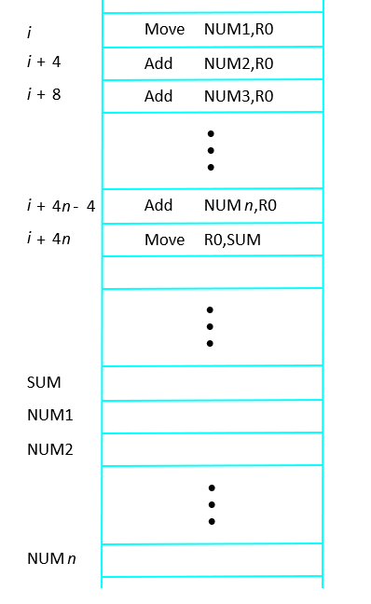
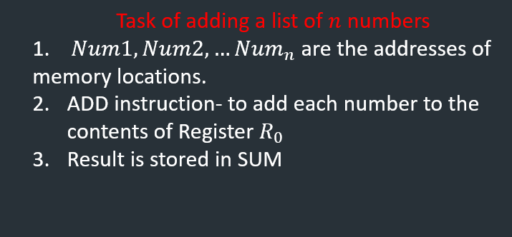

Branching
Fig: Straight line program to add $n$ numbers

Slide 6
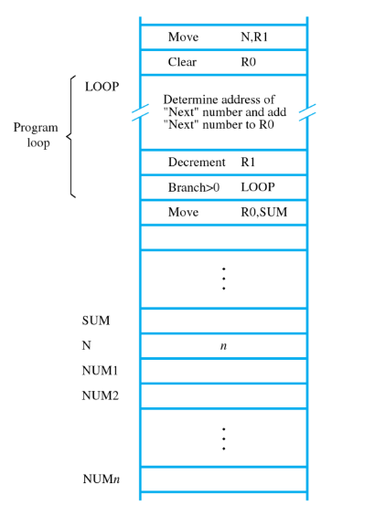

Branching…
Placing single ‘ADD’ instruction in a loop
Loop Executed many times
Register R1 used as counter
BRANCH instruction: it loads a new value called
branch target into program counter.
Fetching and execution happens with new address.
Fig: Using Loop to add $n$ numbers

Slide 7
Condition Codes
N (negative)
Z (zero)
V (overflow)
C (carry)

Slide 8
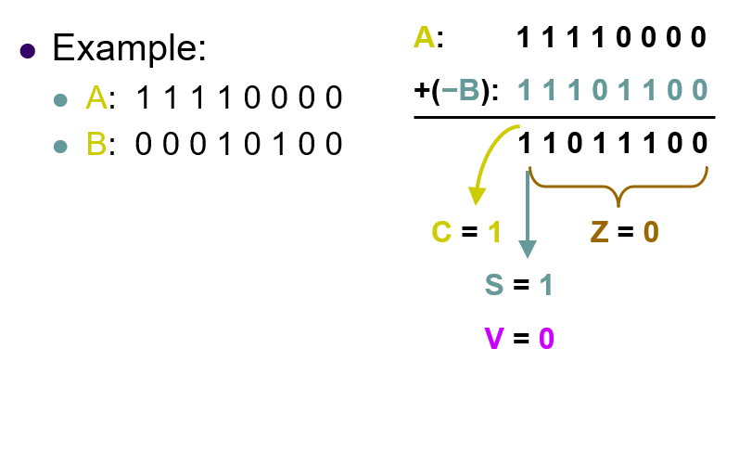

Slide 9
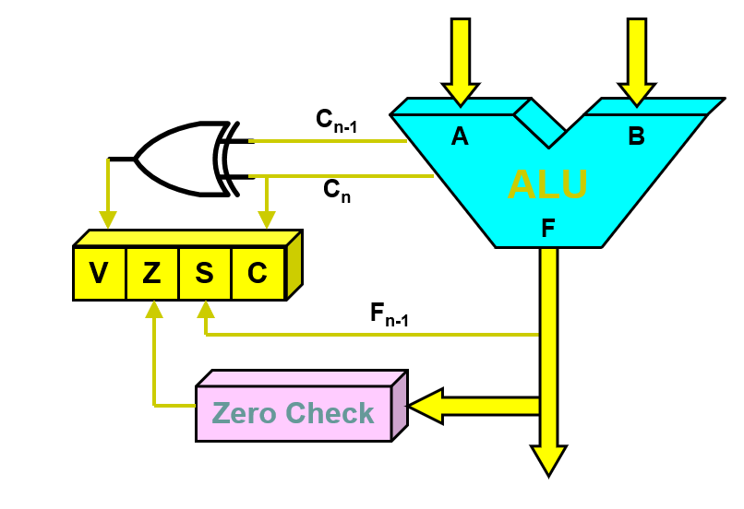
Status

Slide 10
SUBROUTINES and CALL

Slide 11
Subroutines
Particular subtasks performed (many times) using different data values.
Program branches to a subroutine: calling a subroutine (CALL instruction)
By executing ‘RET’ (return instruction); it returns to the main program.
CALL- RET mechanism is ‘SUBROUTINE LINKAGE METHOD’
Link register- saves the return address at specified location

Slide 12
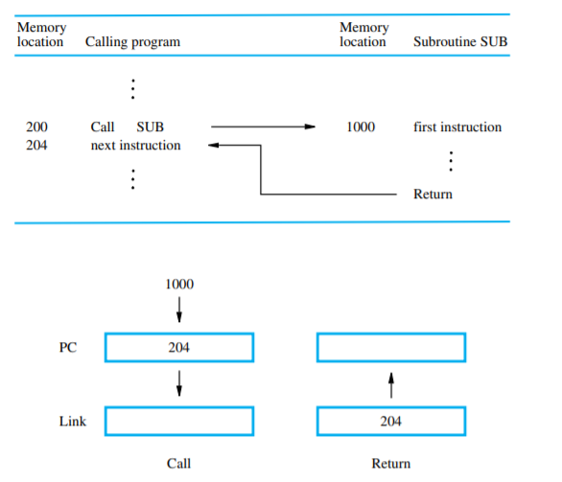

Slide 13
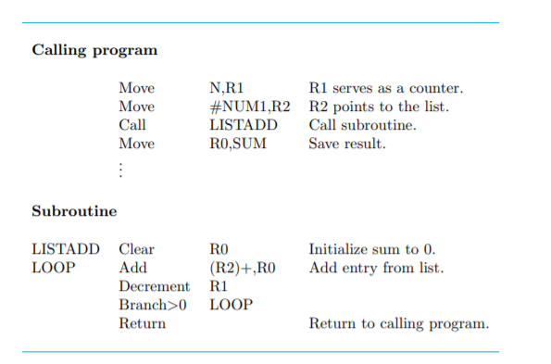

Slide 14
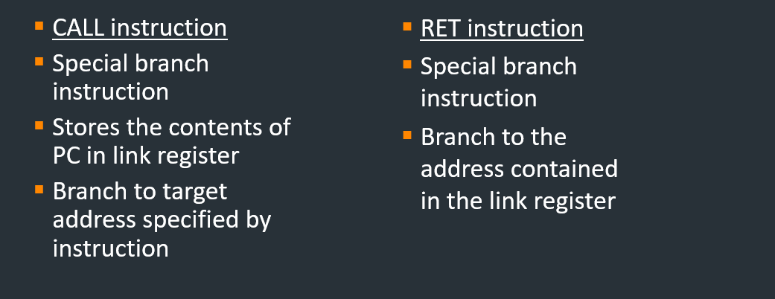
Subroutines

